Slide 1

Course Name- Production Technology for Ornamental Crops, MAP and Landscaping
Course Code- 20014400
Presented By- Dr. Mahendra Kr. Yadav
B.Sc. (Ag.) IV Sem. (Production Technology for Ornamental Crops, MAP and Landscaping)

Slide 2
Course Objectives
Identify different types of ornamental and medicinal crops.
Examine various principles of landscaping, uses of landscape trees, shrubs and climbers, production technology of important ornamental crops, etc.
Determine about Demonstrate various Package of practices for loose flowers and their transportation, storage house and required condition for cut and loose flower.
Construct about the various problems with the production technology of medicinal and aromatic plants.
Importance of Processing and value addition in ornamental crops and MAPs produce.
B.Sc. (Ag.) IV Sem. (Production Technology for Ornamental Crops, MAP and Landscaping)

Slide 3
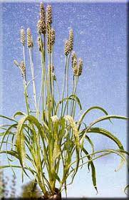
PRODUCTION TECHNOLOGY OF ISABGOL
B.Sc. (Ag.) IV Sem. (Production Technology for Ornamental Crops, MAP and Landscaping)

Slide 4
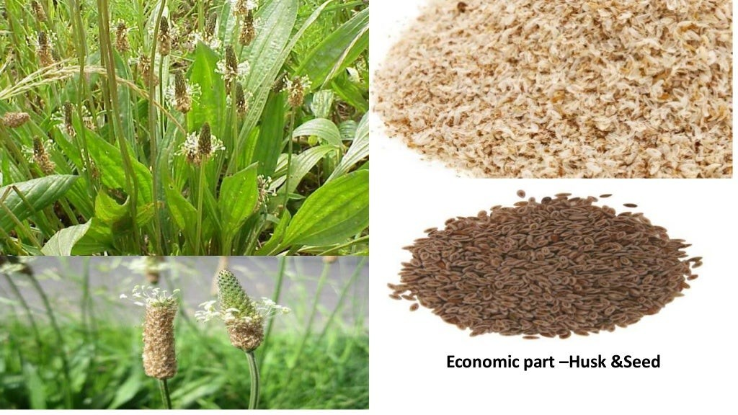
B.Sc. (Ag.) IV Sem. (Production Technology for Ornamental Crops, MAP and Landscaping)

Slide 5
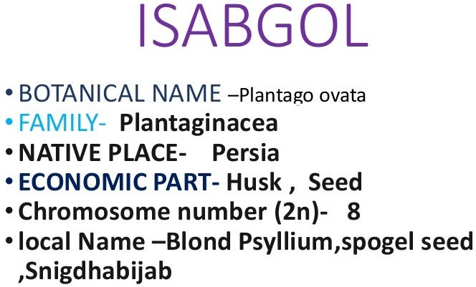
B.Sc. (Ag.) IV Sem. (Production Technology for Ornamental Crops, MAP and Landscaping)

Slide 6
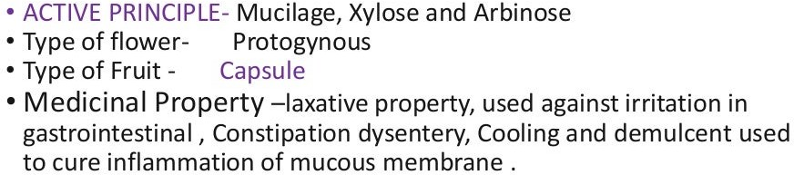
B.Sc. (Ag.) IV Sem. (Production Technology for Ornamental Crops, MAP and Landscaping)

Slide 7
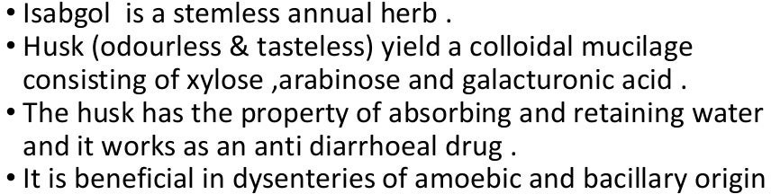
B.Sc. (Ag.) IV Sem. (Production Technology for Ornamental Crops, MAP and Landscaping)

Slide 8
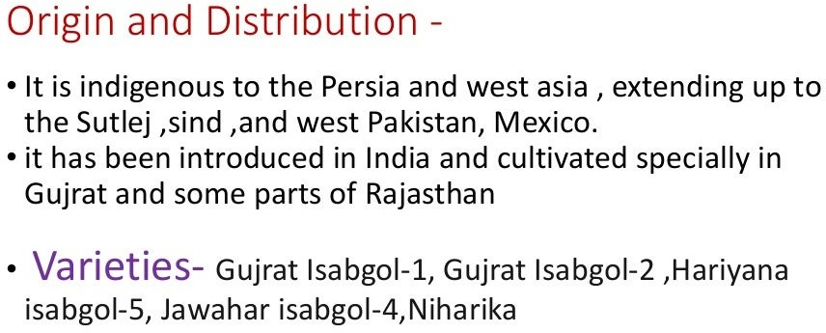
B.Sc. (Ag.) IV Sem. (Production Technology for Ornamental Crops, MAP and Landscaping)

Slide 9
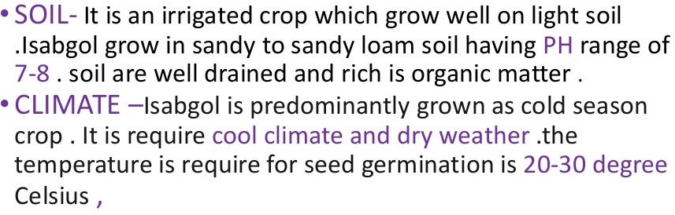
B.Sc. (Ag.) IV Sem. (Production Technology for Ornamental Crops, MAP and Landscaping)

Slide 10
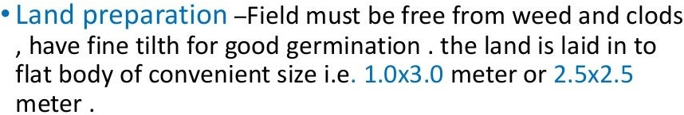
B.Sc. (Ag.) IV Sem. (Production Technology for Ornamental Crops, MAP and Landscaping)

Slide 11
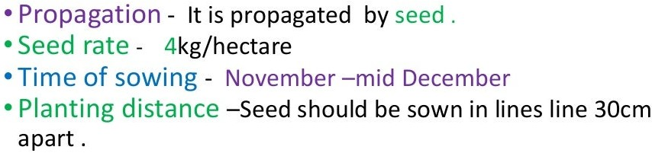
B.Sc. (Ag.) IV Sem. (Production Technology for Ornamental Crops, MAP and Landscaping)

Slide 12
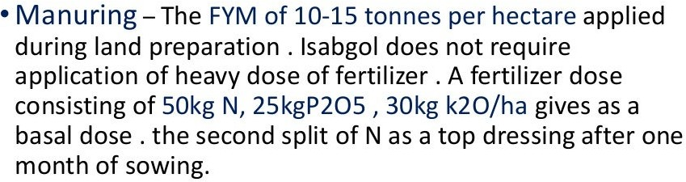
B.Sc. (Ag.) IV Sem. (Production Technology for Ornamental Crops, MAP and Landscaping)

Slide 13
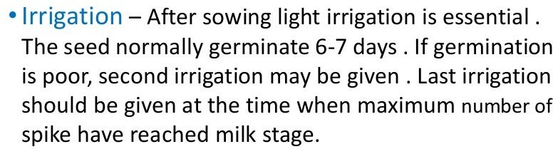
B.Sc. (Ag.) IV Sem. (Production Technology for Ornamental Crops, MAP and Landscaping)

Slide 14
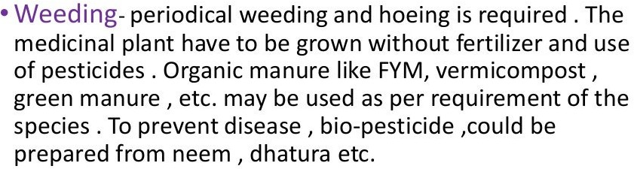
B.Sc. (Ag.) IV Sem. (Production Technology for Ornamental Crops, MAP and Landscaping)

Slide 15
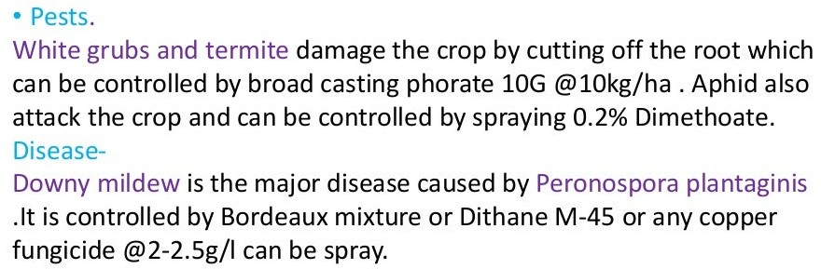
B.Sc. (Ag.) IV Sem. (Production Technology for Ornamental Crops, MAP and Landscaping)

Slide 16
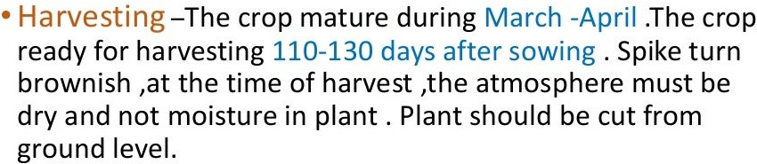
B.Sc. (Ag.) IV Sem. (Production Technology for Ornamental Crops, MAP and Landscaping)

Slide 17
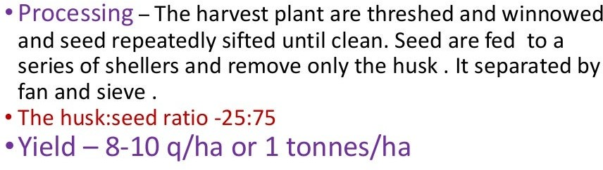
B.Sc. (Ag.) IV Sem. (Production Technology for Ornamental Crops, MAP and Landscaping)

Slide 18

B.Sc. (Ag.) IV Sem. (Production Technology for Ornamental Crops, MAP and Landscaping)

